Slide 1

Algebra 1
Unit 5, Lesson 11 Writing and Solving Systems of Equations for Real-World Contexts Volume 1, pg. 283

Slide 2


Benchmarks
MA.912.AR.9.1
Given a mathematical or real-world context, write and solve a system of two-variable linear equations algebraically or graphically.
MA.912.AR.9.6
Given a real-world context, represent constraints as systems of linear equations or inequalities. Interpret solutions to problems as viable or non-viable options.
volume 1, pg. 283

Slide 3
Integrated Mathematical Thinking and Reasoning Standards
MA.K12.MTR.1.1 Actively participate in effortful learning both individually and collectively.
MA.K12.MTR.2.1 Demonstrate understanding by representing problems in multiple ways.
MA.K12.MTR.3.1 Complete tasks with mathematical fluency.
MA.K12.MTR.4.1 Engage in discussions that reflect on the mathematical thinking of self and others.
MA.K12.MTR.5.1 Use patterns and structure to help understand and connect mathematical concepts.
MA.K12.MTR.6.1 Assess the reasonableness of solutions.
MA.K12.MTR.7.1 Apply mathematics to real-world contexts.
volume 1, pg. 283

Slide 4

Learning Targets
I can write and solve systems of equations in a real-world context.
I can determine the constraints to a system of equations in a real-world context.
I can interpret solutions as viable or non-viable in a context.
volume 1, pg. 283

Slide 5

Warm-Up
volume 1, pg. 284

Slide 6
5.11.1 Warm-Up: Learning Strategies
Learning is not something that just happens, it’s something you do.
Place a checkmark next to the actions you will choose to do today.
I will review my notes and my work.
I will ask questions when I need help.
I will set and maintain a high standard for myself.
I will ask for help if I’m not sure how to get started.
I will remember that my brain grows when I make mistakes.
volume 1, pg. 284

Slide 7
Explain which, if any, strategy you picked demonstrates a growth mindset.
volume 1, pg. 284

Slide 8

Guided Practice
volume 1, pg. 284

Slide 9

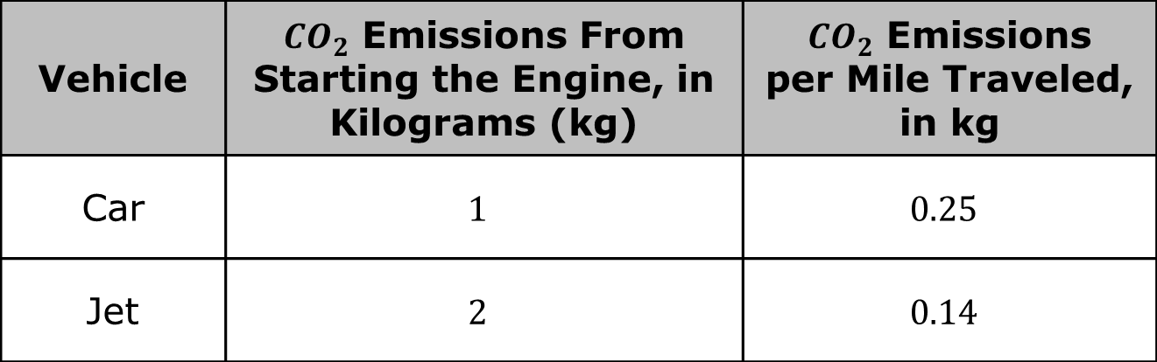
5.11.2 Guided Practice: Writing Systems of Equations
Scientists from NASA have focused their efforts to compare the amount of carbon dioxide (${CO}_{2}$) emitted from different forms of travel.
Vehicle | ${CO}_{2}$ Emissions From Starting the Engine, in Kilograms (kg) | ${CO}_{2}$ Emissions per Mile Traveled, in kg
Car | $$1$$ | $$0.25$$
Jet | $$2$$ | $$0.14$$
volume 1, pg. 284

Slide 10
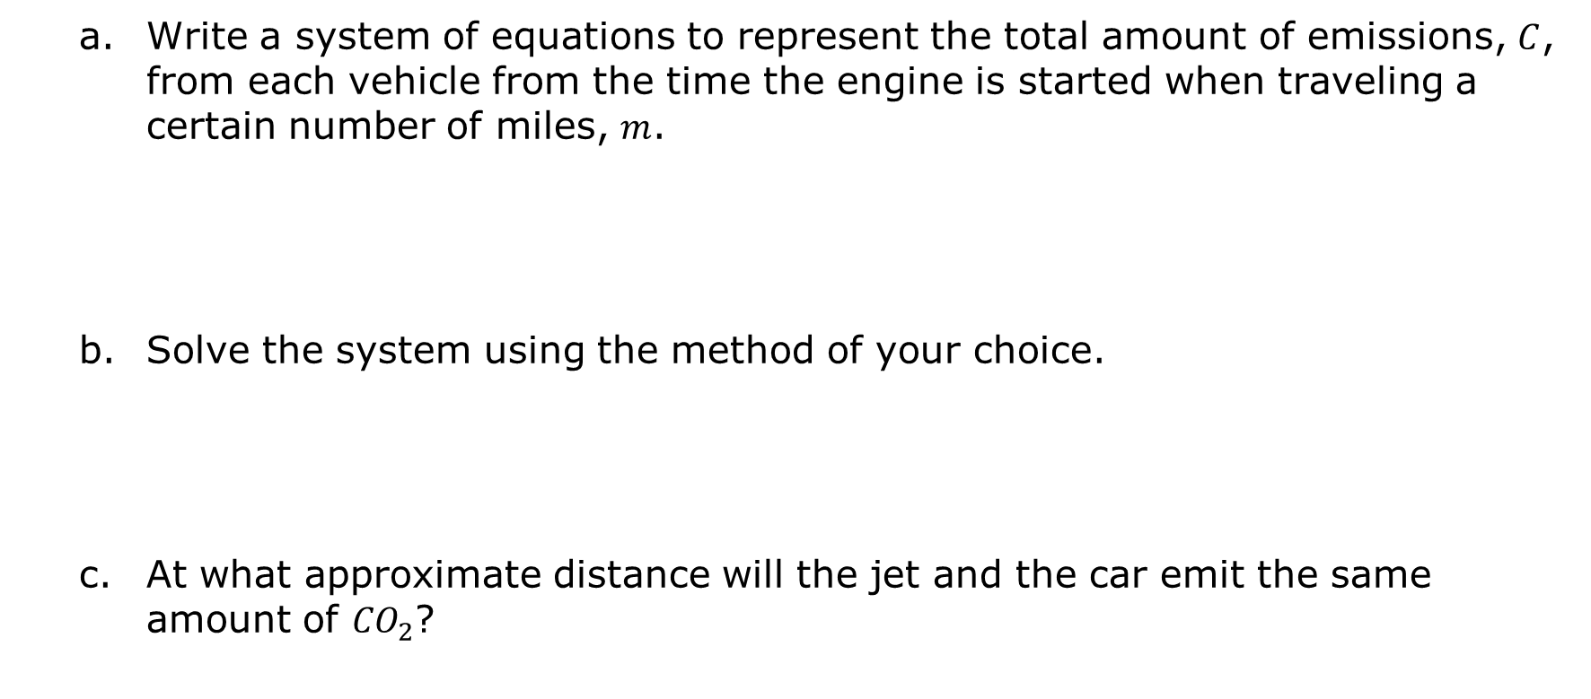
Write a system of equations to represent the total amount of emissions, $C$, from each vehicle from the time the engine is started when traveling a certain number of miles, $m$.
Solve the system using the method of your choice.
At what approximate distance will the jet and the car emit the same amount of ${CO}_{2}$?
volume 1, pg. 284

Slide 11
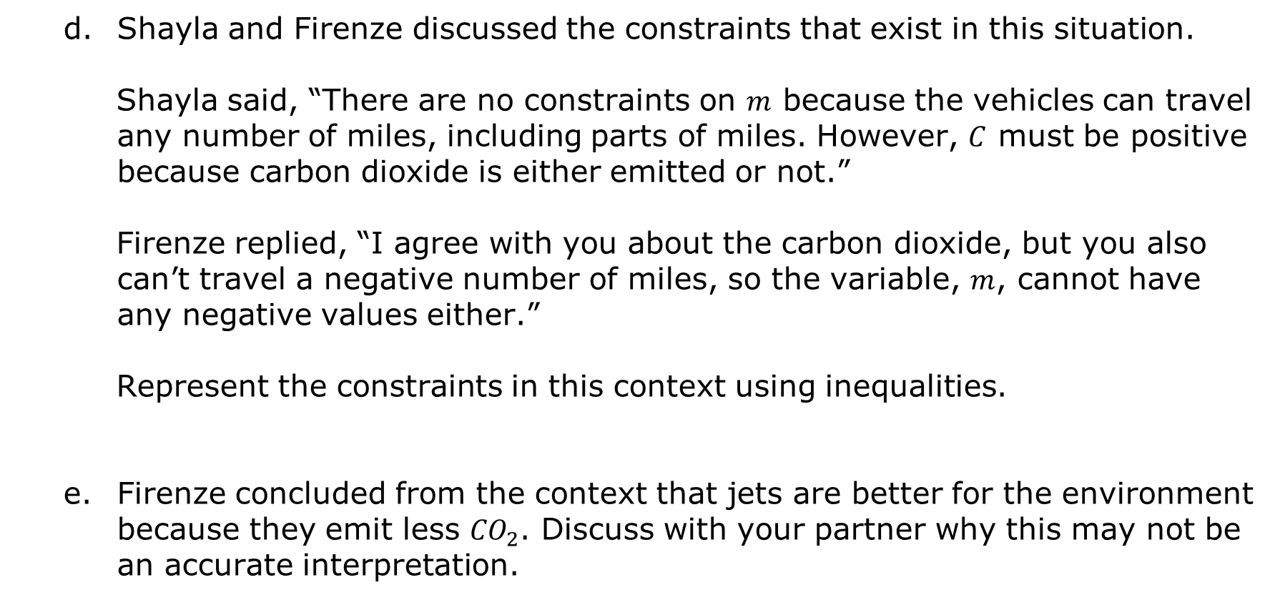
Shayla and Firenze discussed the constraints that exist in this situation.
Shayla said, “There are no constraints on $m$ because the vehicles can travel any number of miles, including parts of miles. However, $C$ must be positive because carbon dioxide is either emitted or not.”
Firenze replied, “I agree with you about the carbon dioxide, but you also can’t travel a negative number of miles, so the variable, $m$, cannot have any negative values either.”
Represent the constraints in this context using inequalities.
Firenze concluded from the context that jets are better for the environment because they emit less ${CO}_{2}$. Discuss with your partner why this may not be an accurate interpretation.
volume 1, pg. 285

Slide 12

Collaboration
volume 1, pg. 285

Slide 13

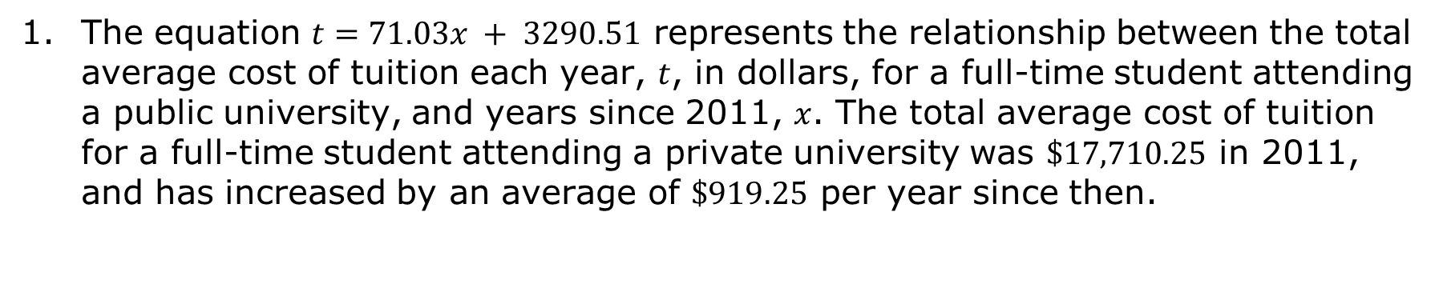
5.11.3 Collaboration: Interpreting Solutions in Context
The equation $t=71.03x + 3290.51$ represents the relationship between the total average cost of tuition each year, $t$, in dollars, for a full-time student attending a public university, and years since 2011, $x$. The total average cost of tuition for a full-time student attending a private university was $\$17,710.25$ in 2011, and has increased by an average of $\$919.25$ per year since then.
volume 1, pg. 285

Slide 14
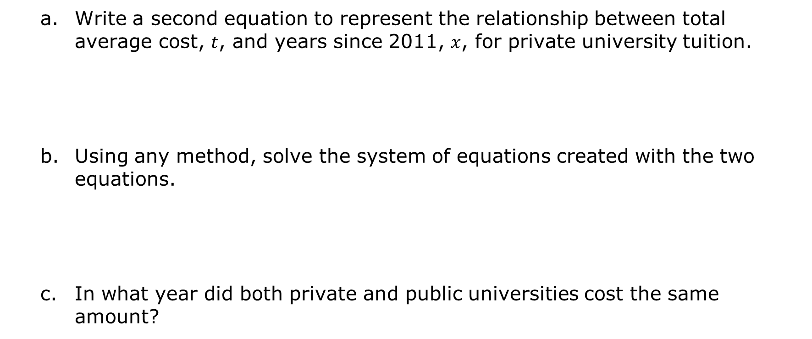
Write a second equation to represent the relationship between total average cost, $t$, and years since 2011, $x$, for private university tuition.
Using any method, solve the system of equations created with the two equations.
In what year did both private and public universities cost the same amount?
volume 1, pg. 285

Slide 15
What was the average total cost of tuition at that time?
volume 1, pg. 286

Slide 16
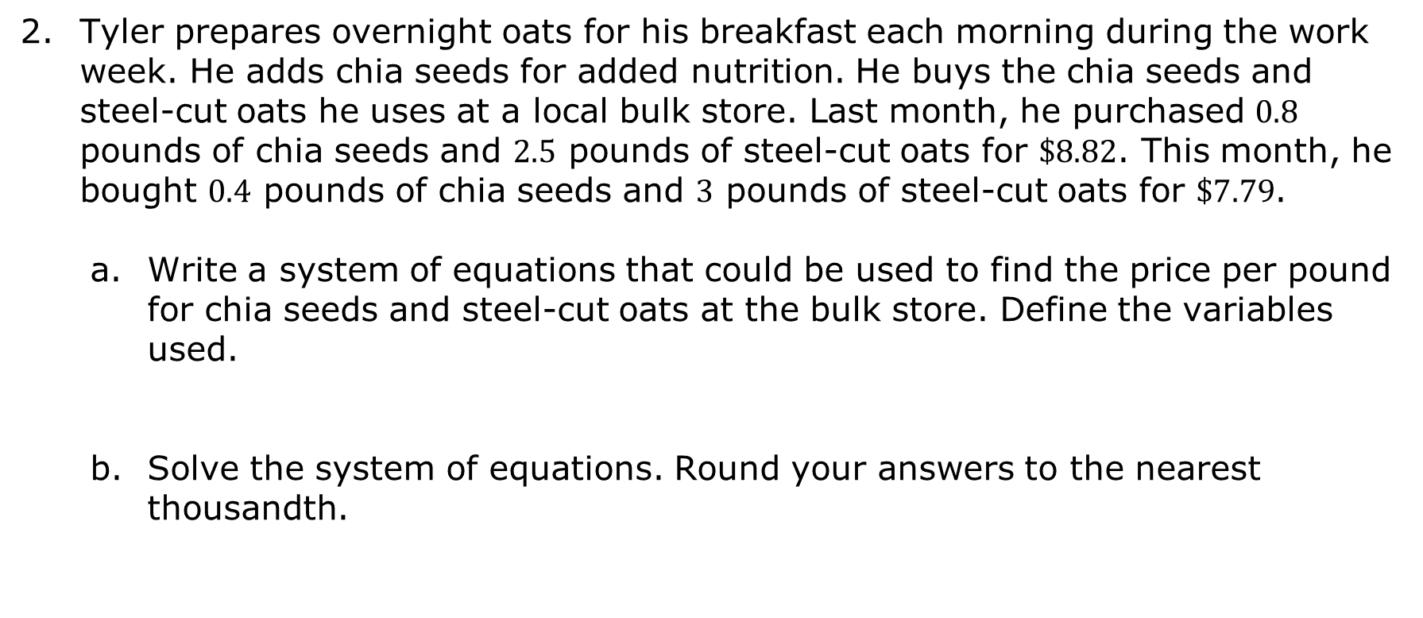
Tyler prepares overnight oats for his breakfast each morning during the work week. He adds chia seeds for added nutrition. He buys the chia seeds and steel-cut oats he uses at a local bulk store. Last month, he purchased $0.8$ pounds of chia seeds and $2.5$ pounds of steel-cut oats for $\$8.82$. This month, he bought $0.4$ pounds of chia seeds and $3$ pounds of steel-cut oats for $\$7.79$.
Write a system of equations that could be used to find the price per pound for chia seeds and steel-cut oats at the bulk store. Define the variables used.
Solve the system of equations. Round your answers to the nearest thousandth.
volume 1, pg. 286

Slide 17
Discuss with your partner any constraints on the variables in this context. Then, summarize your discussion.
Based on your work in Part B and discussion in Part C, interpret a viable solution to the problem.
volume 1, pg. 286

Slide 18

Your Turn
volume 1, pg. 287

Slide 19
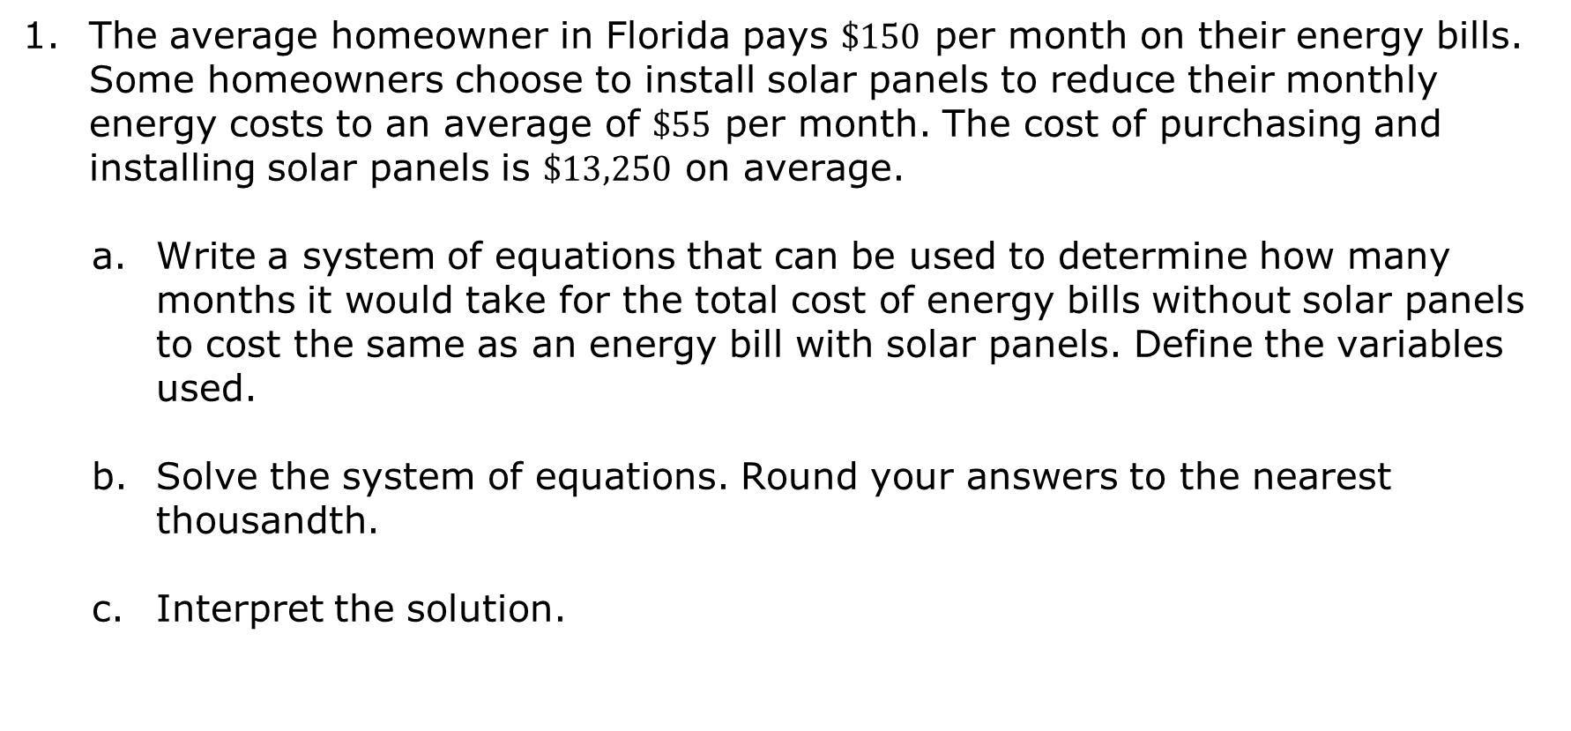
5.11.4 Your Turn!
The average homeowner in Florida pays $\$150$ per month on their energy bills. Some homeowners choose to install solar panels to reduce their monthly energy costs to an average of $\$55$ per month. The cost of purchasing and installing solar panels is $\$13,250$ on average.
Write a system of equations that can be used to determine how many months it would take for the total cost of energy bills without solar panels to cost the same as an energy bill with solar panels. Define the variables used.
Solve the system of equations. Round your answers to the nearest thousandth.
Interpret the solution.
volume 1, pg. 287

Slide 20

Wrap-Up
volume 1, pg. 287

Slide 21
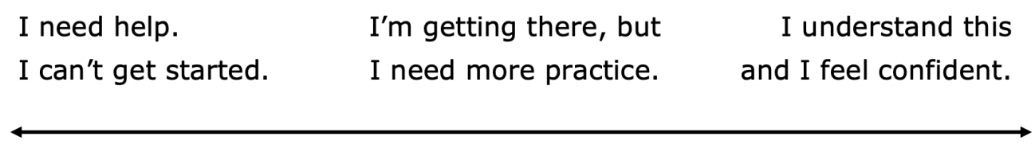
5.11.5 Wrap-Up: Reflection
Draw an X on each line to indicate how you feel about each learning target.
I can write and solve systems of equations in a real-world context.
I can interpret solutions as viable or non-viable in a given context.
volume 1, pg. 287

